Slide 1
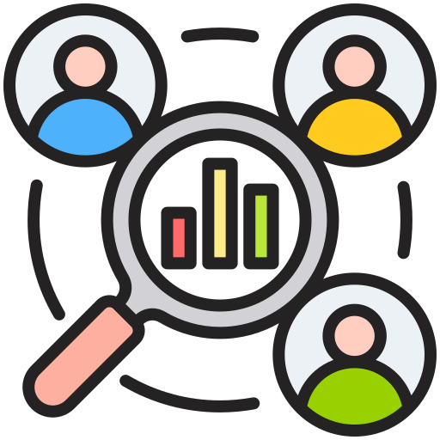
Telecom Customer Analytics
User Engagement, Experience & Satisfaction Analysis
Project 5 – Data Analytics & Machine Learning
Presented By: Data Analytics
Bhawna Chouhan Internship Project NextHikes
August 2026

Slide 2
Project Overview
Business Problem
Analyze telecom customer behaviour using network usage and application data.
Understand user engagement, experience, and satisfaction.
Support data-driven business decisions through analytics.
Project Objectives
Perform User Overview Analysis
Analyze User Engagement using session frequency, duration, and traffic
Segment users using K-Means clustering
Evaluate User Experience using RTT, TCP Retransmission, and Throughput
Calculate and analyze Customer Satisfaction
Perform duration-based user segmentation
Export final satisfaction results to SQL Server
Verify the exported results using SQL queries
Tools & Technologies
Python
Pandas & NumPy
Matplotlib & Seaborn
Scikit-learn
(K-Means Clustering)
SQL Server (SSMS)
VS Code
Jupyter Notebook

Slide 3
Business Understanding & Problem Statement
Business Context
TellCo is a mobile service provider with a large customer base.
The company wants to better understand customer behaviour using telecom usage data.
The analysis supports informed business decisions and identifies opportunities for business growth.
Problem Statement
Customer behaviour patterns are not clearly understood.
There is a need to analyze user engagement, experience, and satisfaction.
The results will help identify customer segments and support strategic decision-making.
Project Goal
Analyze telecom customer data using Python and Machine Learning.
Generate actionable business insights.
Store the final results in SQL Server for future reporting and analysis.

Slide 4
Dataset Overview
Dataset Description
Telecom customer usage dataset containing 150,001 customer session records collected
From aggregated xDR (Data Session Detail Records).
Dataset consists of 55 features describing customer sessions and network usage.
Records include customer activity, application usage, device information,
and network performance metrics.
Used to analyze customer behaviour, engagement, experience, and satisfaction.
Key Data Categories
User Information
Device & Manufacturer Information
Network Usage Metrics
Application Traffic (DL & UL)
Session Duration
Network Quality Metrics (RTT, TCP & Throughput)
Project Analysis Flow
Telecom Customer Dataset
User Overview Analysis
User Engagement
Analysis
User Experience
Analysis
Customer Satisfaction Analysis
Initial Dataset
• 150,001 session records
• 55 original features
After Preprocessing
• 150,001 records retained
• 49 final features
• 0 missing values
• 0 duplicate records

Slide 5
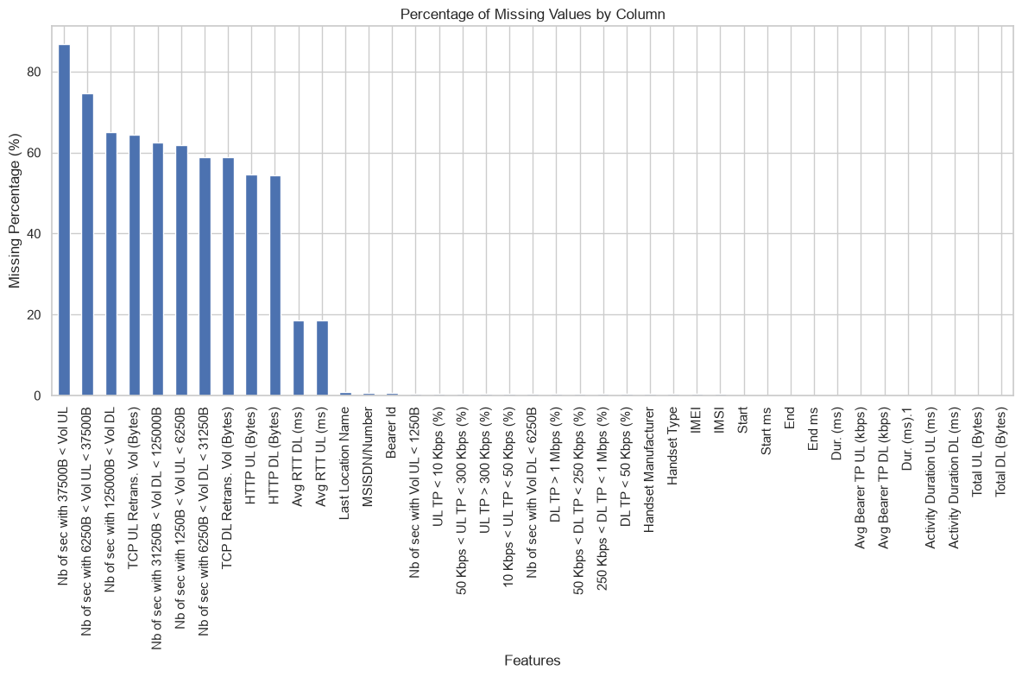
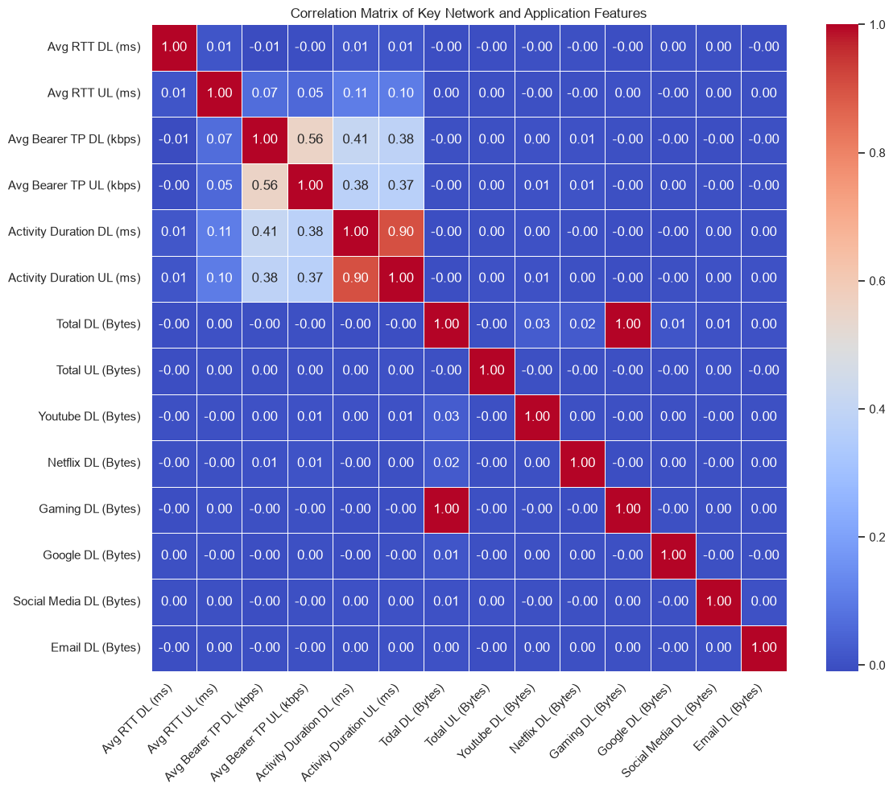
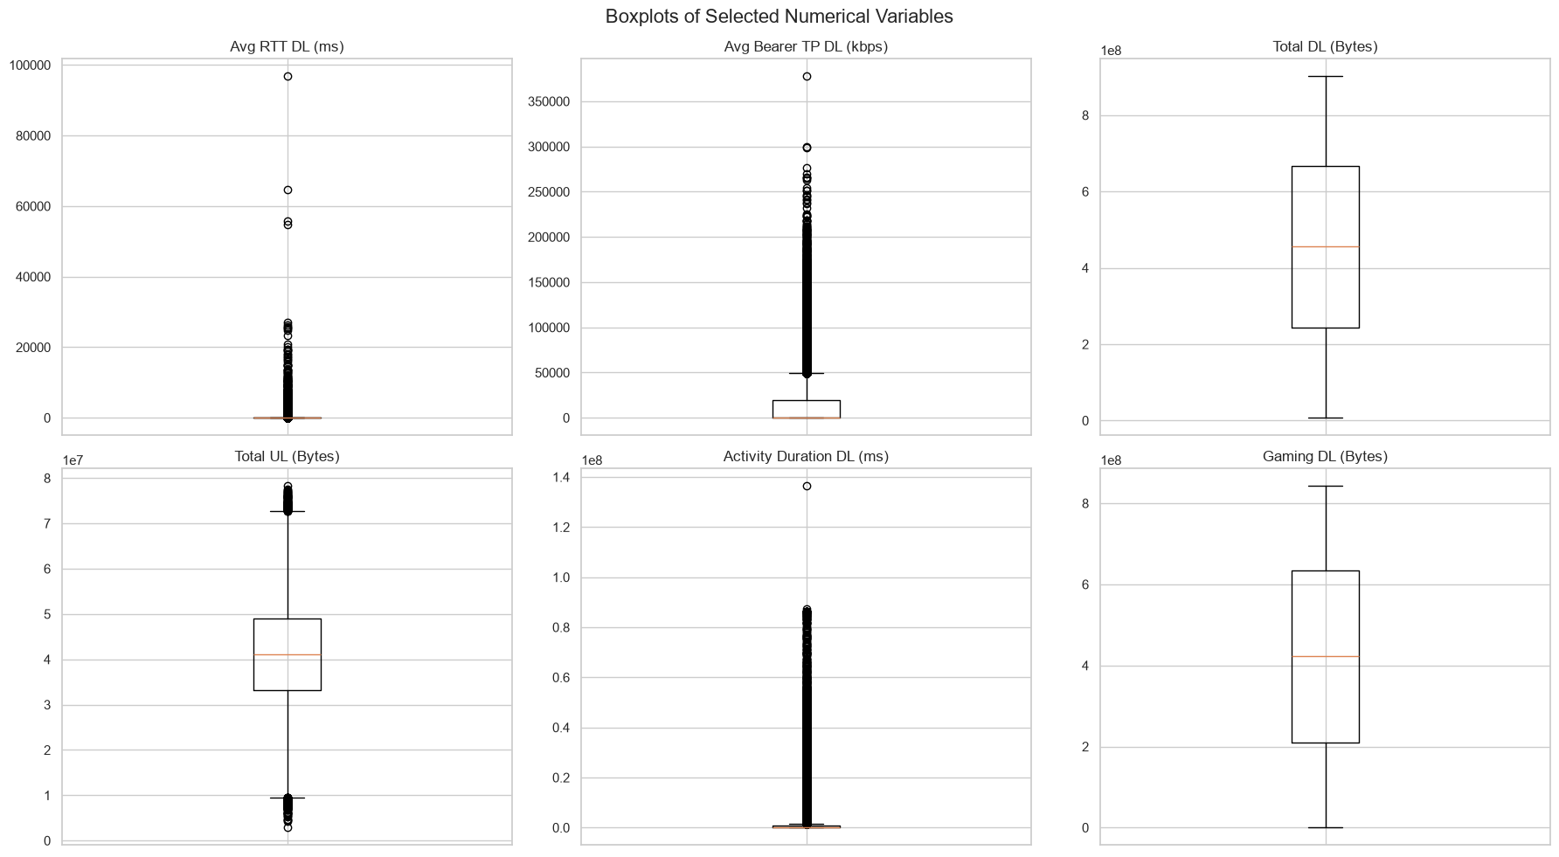
Data Preprocessing & EDA
Data Preprocessing
Checked missing values and duplicate records
Six features had more than 60% missing values
Very-high-missing features (>60%) were removed after evaluation
Remaining numerical missing values were imputed using the median
Categorical values were handled using the mode where applicable
Outliers were identified using boxplots and retained when they represented
valid telecom behavior.
Final validation confirmed 0 missing values and 0 duplicate records
Exploratory Data Analysis
Skewed distributions observed in
RTT, Throughput, and Activity Duration.
Correlation analysis identified
relationships among key network metrics.
EDA revealed significant outliers and user variability.

Slide 6
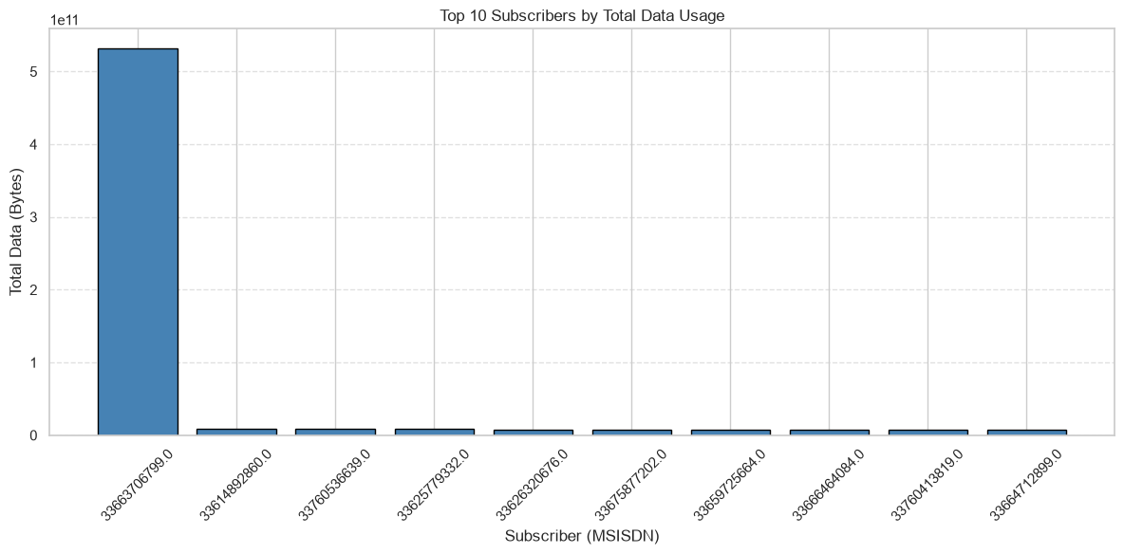
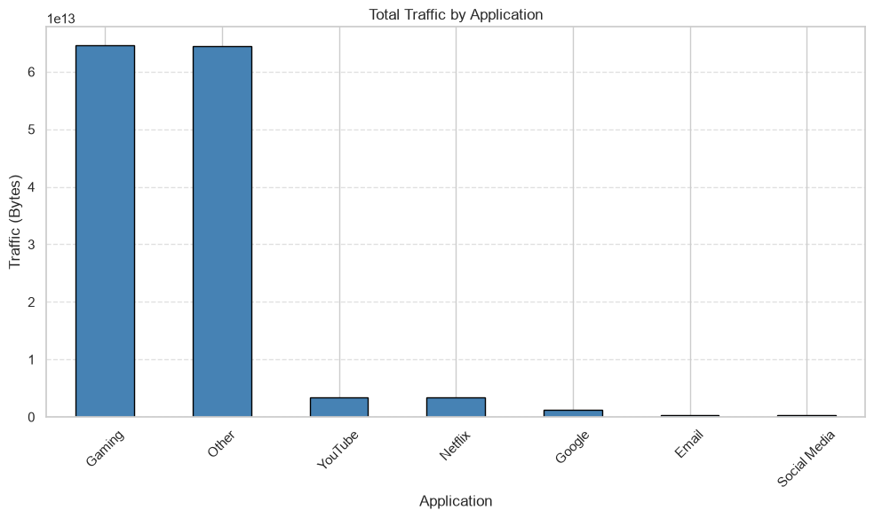
User Overview Analysis
Key Findings
User traffic was aggregated at subscriber (MSISDN) level
Gaming and Other generated the highest total traffic
YouTube was the third-highest application by total traffic
Netflix and Google showed lower traffic than the top three applications
One subscriber recorded exceptionally high total data usage
User-level summaries were prepared for engagement and satisfaction analysis
Business Insight
High-data users can be targeted with premium plans.
Application usage patterns support network optimization and customer segmentation.

Slide 7
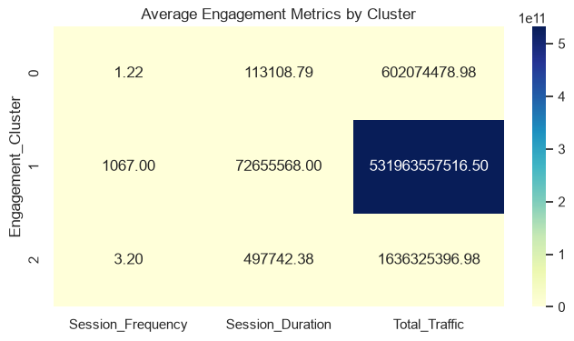
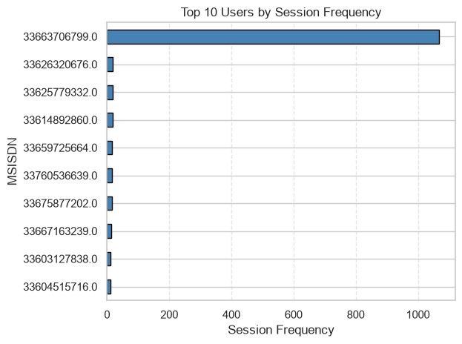
User Engagement Analysis
Key Findings
Engagement was measured using session frequency, session duration, and total traffic.
Subscriber 33663706799 ranked highest across all three metrics: 1,067 sessions, 72.66 million ms duration, and 531.96B bytes traffic.
K-Means (k=3) segmented users into low, moderate, and high engagement groups.
Cluster 0: 97,671 users → lowest engagement.
Cluster 2: 9,184 users → moderate engagement.
Cluster 1: 1 user → exceptionally high engagement.
Business Insight
Low-engagement users: promotional campaigns.
Moderate users: upgrade/personalized plans.
Highly engaged users: premium services, retention and network capacity planning.

Slide 8
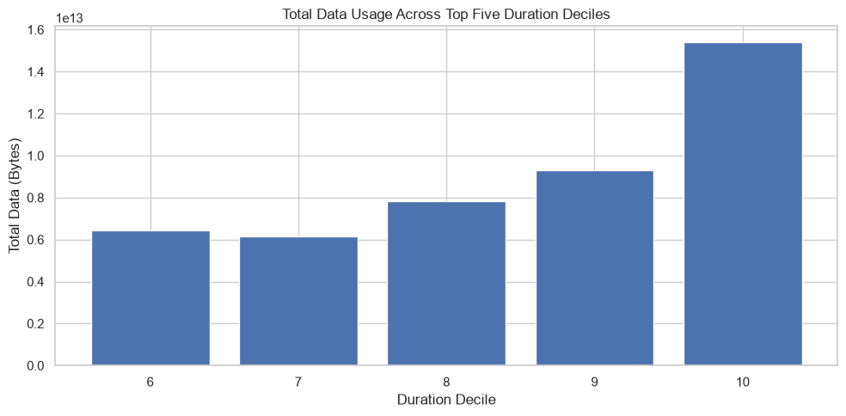
Duration Decile Analysis
Objective
Segment users into 10 duration-based deciles and analyze
total data consumption across the highest-duration groups.
Key Findings
Users were divided into 10 duration deciles based on session duration
Top five duration groups: Deciles 6–10
Each group contains approximately 10,685–10,686 users
Total data consumption generally increases with session duration
Decile 10 recorded the highest total duration:
5.18 billion ms
Decile 10 also recorded the highest total data usage:
15.40 trillion bytes
Business Insight
High-duration users represent an important high-usage segment.
These users can support:
Network capacity planning
Customer segmentation
Targeted service strategies

Slide 9
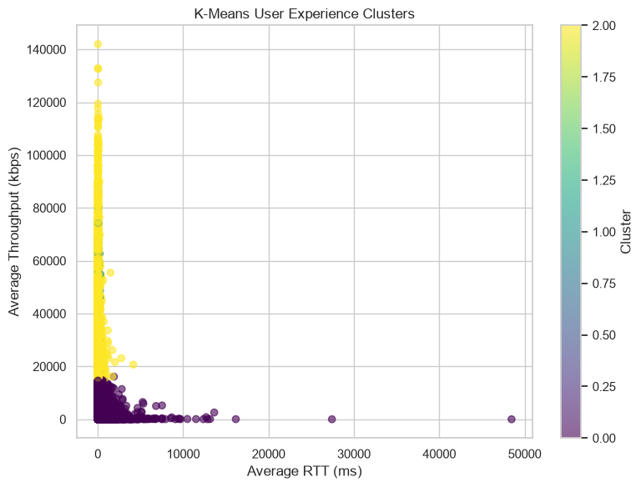
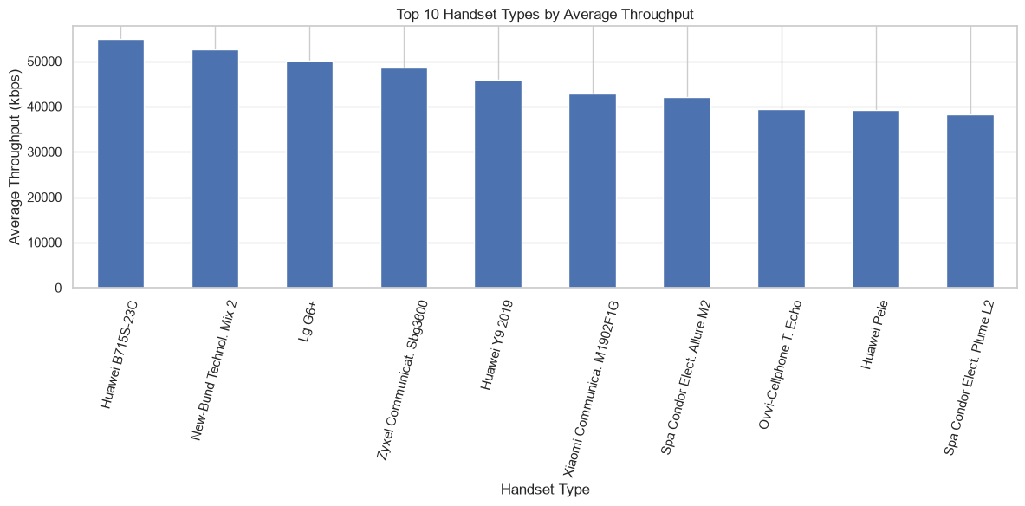
User Experience Analysis
Key Insights
Evaluated user experience using RTT, TCP Retransmission, and Throughput.
Performance differs across handset types, indicating device-specific network quality.
Cluster 2 delivers the most balanced user experience.
Business Impact
Improve throughput for Cluster 0 (low throughput).
Reduce high latency & retransmission in Cluster 1.
Use Cluster 2 as the performance benchmark.

Slide 10
Customer Satisfaction Methodology
How Satisfaction Was Calculated
1. Engagement Score
• Measures distance from the least-engaged cluster
2. Experience Score
• Measures distance from the worst-experience cluster
3. Score Normalization
• Engagement and experience scores were normalized
• This puts both measures on a comparable scale
4. Satisfaction Score
• Calculated as the average of normalized
Engagement and Experience Scores
5. Satisfaction Clustering
• K-Means with k = 2
• Identified two customer satisfaction segments

Slide 11
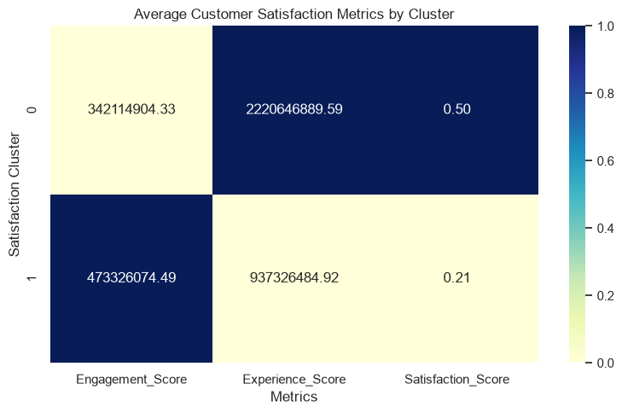
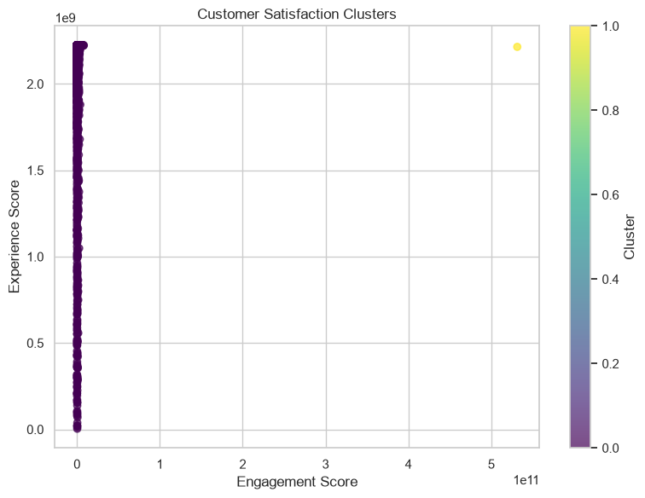
User Satisfaction Analysis
Key Findings
• Two satisfaction clusters were identified using K-Means (k = 2)
• Cluster 0 has the higher average Satisfaction Score: 0.50
• Cluster 1 has the lower average Satisfaction Score: 0.21
• Cluster 1 has higher average engagement
• Cluster 0 has substantially higher average experience
• Higher engagement alone does not guarantee higher satisfaction
Business Impact
• Prioritize lower-satisfaction customers for network improvement
• Improve network experience where service quality is weak
• Use satisfaction segments for targeted retention strategies
• Evaluate engagement and network experience together

Slide 12
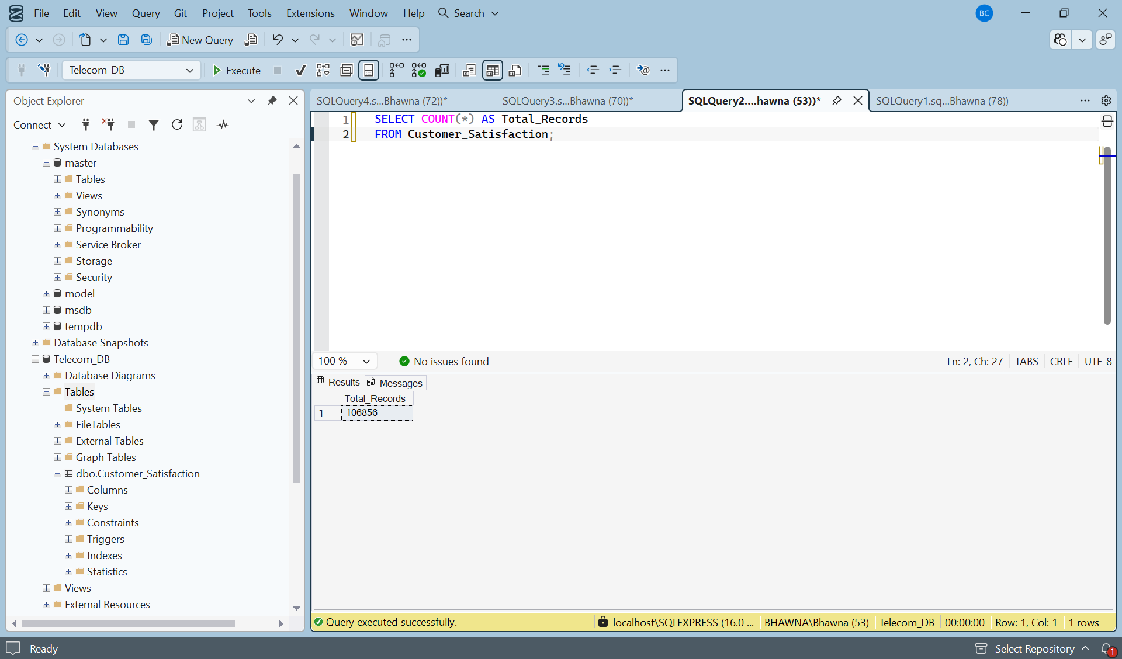
SQL Server Integration
Database Integration
Connected Jupyter Notebook to SQL Server (Telecom_DB)
Created final Customer_Satisfaction table
Exported 106,856 customer records
Verification
SQL queries confirmed successful data storage
Retrieved sample records and summary statistics
Satisfaction-cluster distribution successfully verified
Analysis results successfully integrated into SQL Server for future querying and reporting.

Slide 13
Key Insights
Overall Findings
Network performance — RTT, throughput and TCP retransmission strongly affect user experience.
Application usage — Gaming, Other, and YouTube are the top three applications by total traffic.
Customer segmentation — K-Means identified distinct engagement and experience groups.
Satisfaction — Combined engagement and experience scores identify customers needing improvement.
Data integration — Final results were successfully stored and verified in SQL Server.
Business Takeaway
Use customer segments and network-performance insights to improve service quality and retention.

Slide 14
Business Value
Improve customer satisfaction
Identify customers experiencing poor network performance
Optimize network infrastructure and capacity
Support data-driven investment decisions
Improve customer retention through targeted strategies
Maintain centralized reporting through SQL Server

Slide 15
Recommendations
Network Improvements
Improve network throughput in low-performance areas.
Reduce TCP retransmissions and RTT (latency).
Monitor high-traffic applications for capacity planning.
Customer Strategy
Prioritize low-satisfaction customers for service improvement.
Continuously update satisfaction scores using new network data.
Overall Recommendation: Focus on improving network quality for low-performing users while retaining high-value customers through personalized services.
Data & Reporting
Store customer satisfaction metrics in SQL Server
Use SQL queries for centralized reporting and verification
Maintain the database as a foundation for future analytics

Slide 16
Investment Decision
Main recommendation : BUY WITH CONDITIONS
Supporting Evidence
• Strong customer activity across major applications
• Gaming, Other, and YouTube are the top three traffic-generating applications
• K-Means identified distinct engagement, experience, and satisfaction segments
• Lower-satisfaction customers provide opportunities for service improvement
• RTT, throughput, and TCP retransmission reveal network optimization opportunities
• Final customer-level analysis was successfully integrated into SQL Server
Decision Rationale
TellCo should be considered for acquisition with conditions.
The investment should be supported by a clear plan to:
• Improve network quality
• Address lower-satisfaction customer segments
• Optimize resources around high-traffic usage patterns
• Improve customer retention and network efficiency

Slide 17
Challenges Faced
Missing values & data preprocessing
Large-scale telecom dataset handling
Selecting K-Means clustering parameters
Feature normalization before clustering
Python → SQL Server integration
SQL verification of exported results
How They Were Addressed?
Data Cleaning → Missing-value analysis & appropriate imputation
Clustering → Standardization + K-Means
Database → SQL Server connection and record verification

Slide 18
Limitations & Future Scope
Limitations
Analysis is based on one month of aggregated xDR data
Several network features contained substantial missing values
Network variables showed high variability and extreme observations
Satisfaction is a derived analytical score, not direct customer feedback
Clustering results depend on selected features and methodology
Future Scope
Real-time customer satisfaction monitoring
Interactive Power BI dashboard
Advanced ML models for satisfaction prediction
Live telecom network data integration
Automated customer alerts
Larger datasets & additional network indicators

Slide 19
Conclusion & References
Conclusion
• Successfully analyzed telecom customer behaviour, engagement, experience, satisfaction, and duration-based usage patterns
• K-Means identified distinct engagement, experience, and satisfaction segments
• Duration decile analysis identified high-duration, high-traffic customer groups
• Satisfaction was derived from normalized engagement and experience scores
• Network-performance opportunities were identified for improving customer experience
• Final satisfaction results were successfully exported and verified in SQL Server
Final Takeaway
Data-driven customer segmentation and network-performance analysis can help TellCo improve service quality, customer satisfaction, retention, and network resource planning.
References
Pandas
NumPy
Scikit-learn
Matplotlib
Seaborn
SQLAlchemy • Microsoft SQL Server • PyODBC

Slide 20
Project Achievements & Completion
Project Successfully Completed
✔ Data cleaning and preprocessing completed
✔ Exploratory Data Analysis completed
✔ User overview and engagement analysis completed
✔ Duration-based segmentation completed
✔ User experience analysis completed
✔ K-Means clustering applied to customer segments
✔ Customer satisfaction scoring completed
✔ Business recommendations developed
✔ SQL Server integration completed
✔ Customer satisfaction results verified using SQL queries
Final Outcome
The project transformed raw telecom network data into actionable customer, network, and satisfaction insights that can support business decision-making, customer retention, and network optimization.

